Slide 1
Design and Modeling of Arithmetic Logic unit
Presenter:
TEJAS MESHRAM
MEC2021015

Slide 2
Content
Introduction
Schematic
Modeling/Design Issues
Verification methods
Codes (Highlights of Top level modules and testbench)
Functional simulation Results
Conclusion
References

Slide 3
INTRODUCTION
Reduced instruction set computer (RISC) is a computer designed to simplify the individual instructions given to the computer in order to realise a task.
The RISC computer usually has many (16 or 32) high-speed, general-purpose registers with a load/store architecture in which the code for the register-register instructions (for performing arithmetic and tests) are separate from the instructions that grant access to the main memory of the computer.

Slide 4
Schematic

Slide 5
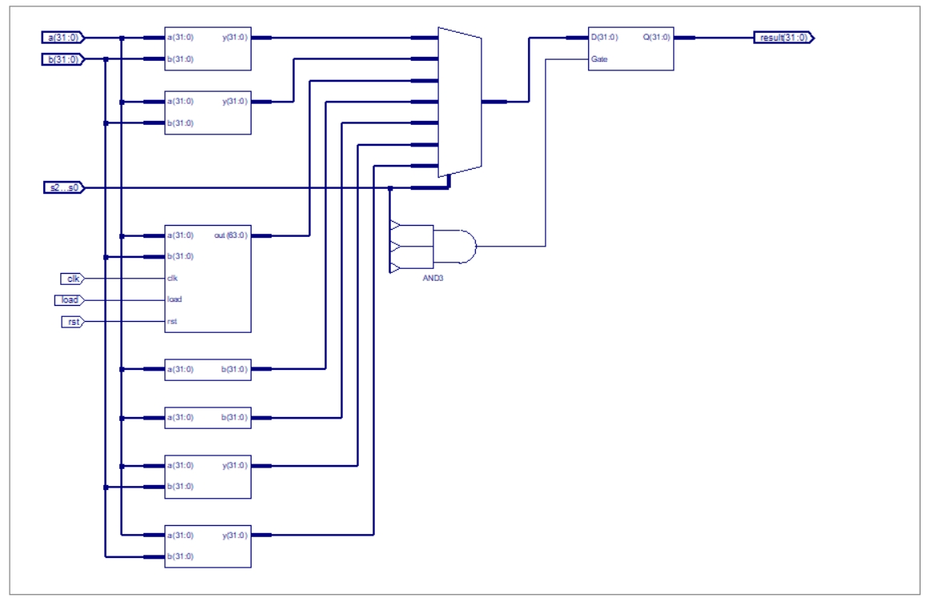

Slide 6
Modeling/Design Issues
Error – getting Z high impedance at output in clk and reset for booth multiplier
Solution – issue solved by giving forever inverted clk input and giving reset to logic 0

Slide 7
Code – Alu design

Slide 8
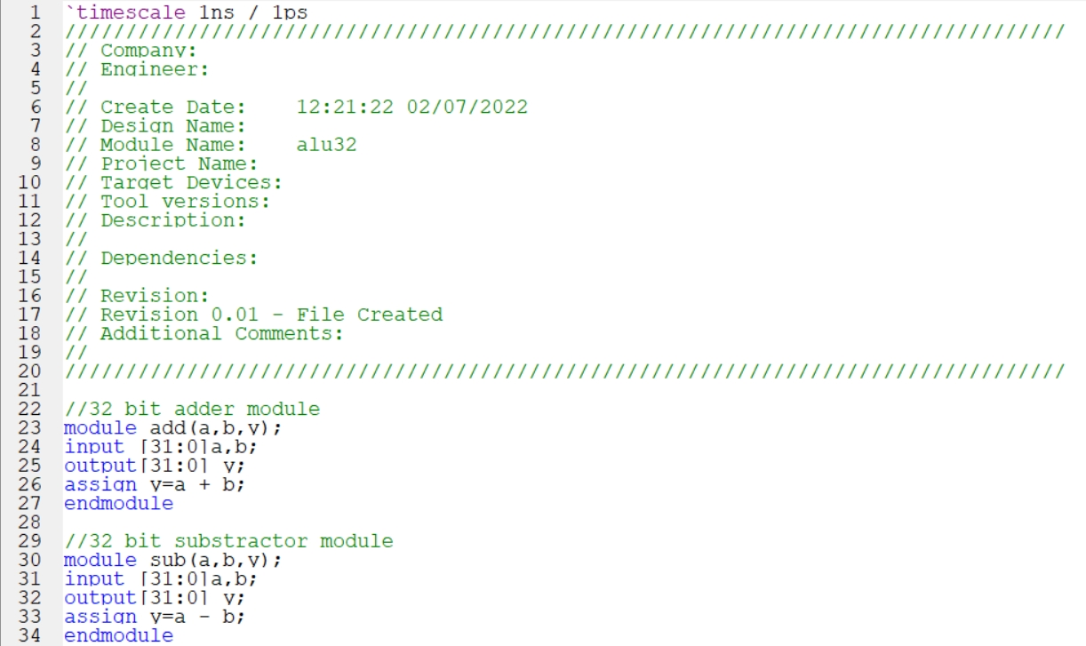

Slide 9
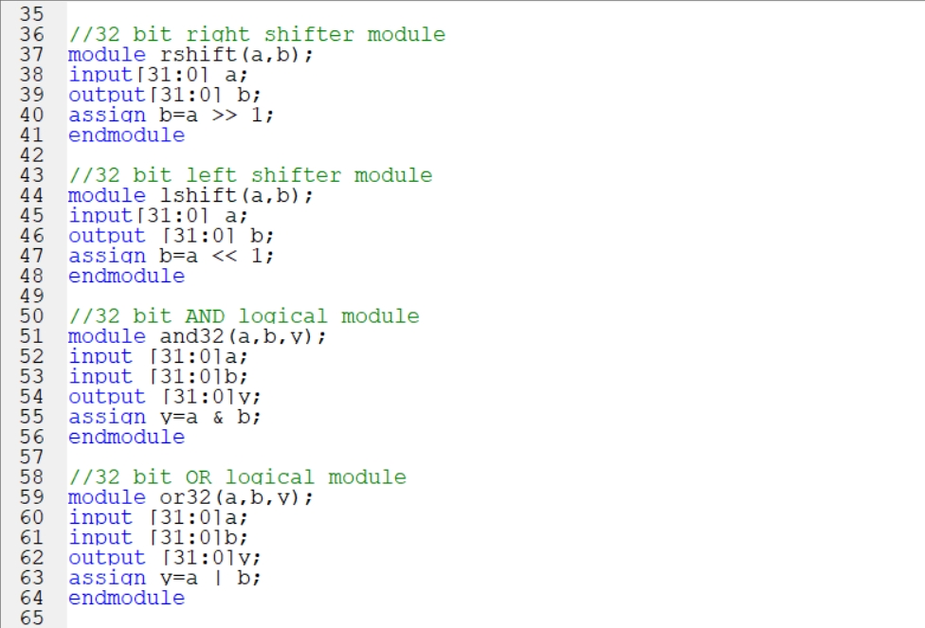

Slide 10
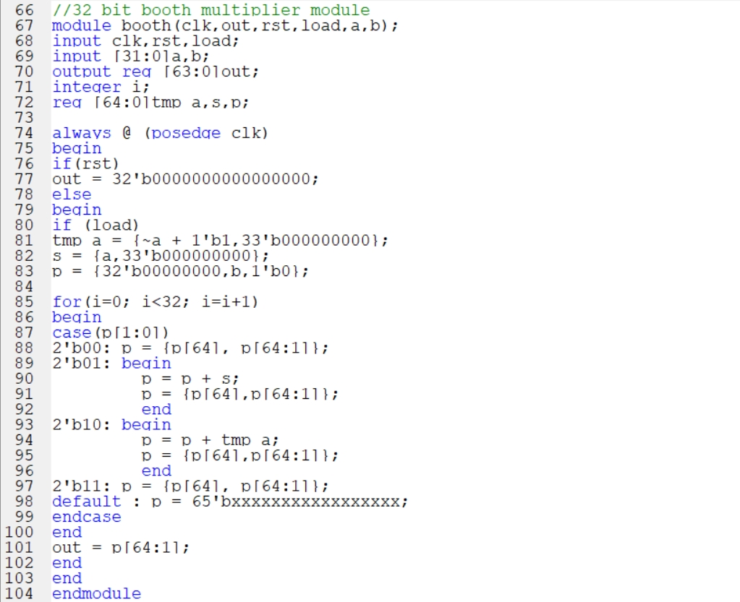

Slide 11
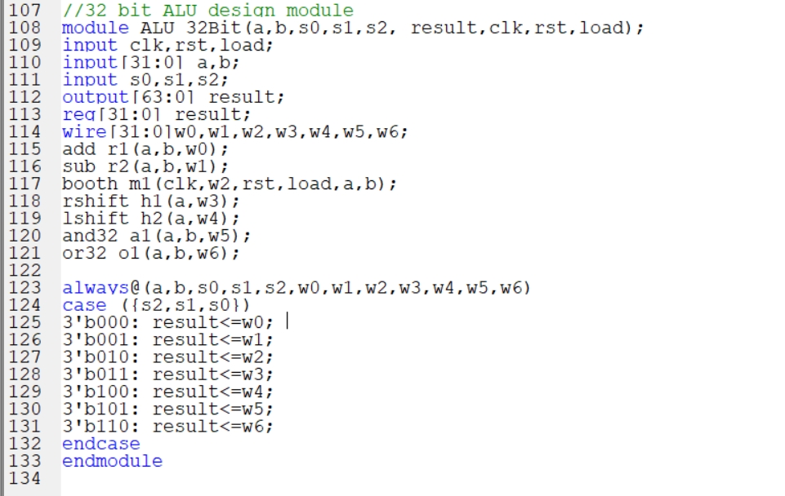

Slide 12
Code
TestBench

Slide 13
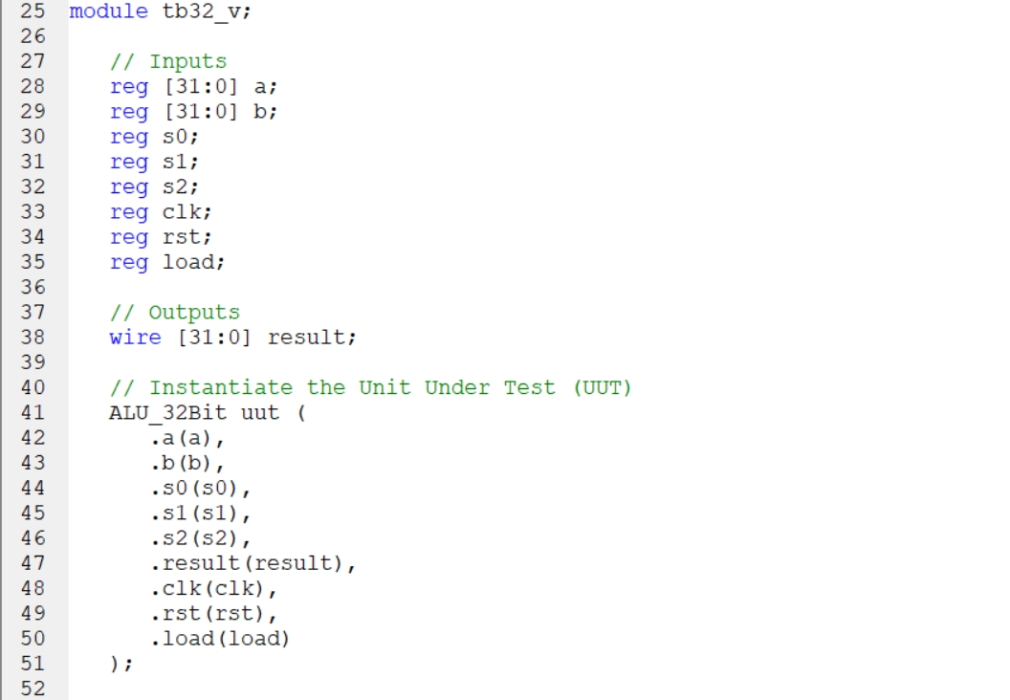

Slide 14
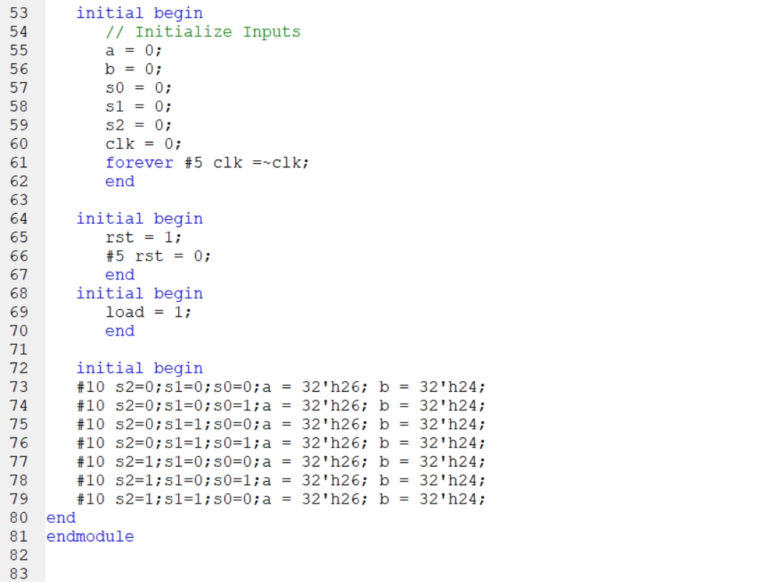

Slide 15
Functional Simulation Results

Slide 16
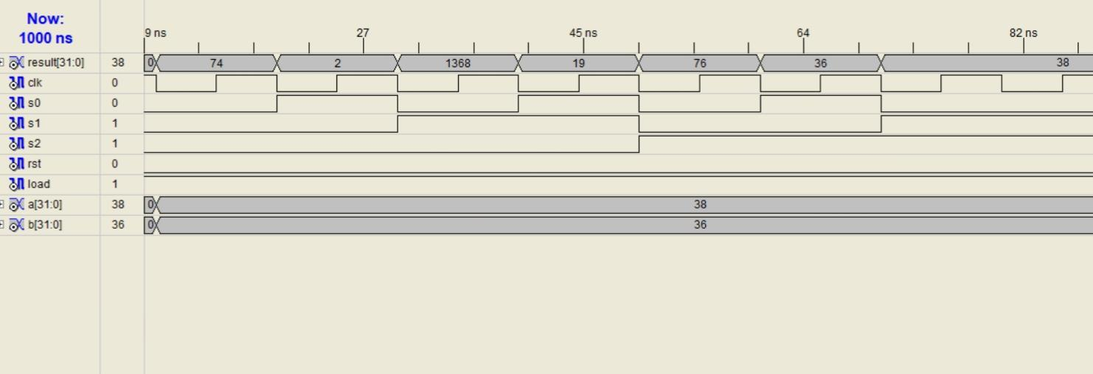
Booth
multp
Right
shift
left
shift
Add
sub
OR
AND

Slide 17
Conclusion
It is very flexible to design and implement as compared to cisc module
Separate module are defined and called making it conveninet to understand

Slide 18
References and Web links used
[1] Berezinski, John. "RISC: Reduced Instruction set Computer". Department of Computer Science, Northern Illinois University. Archived from the original on 28 February 2017.
[2] Waterman, Andrew; Lee, Yunsup; Patterson, David A.; Asanovi, Krste. "The RISC-V Instruction Set Manual, Volume I: Base User-Level ISA version 2 (Technical Report EECS-2014-54)". University of California, Berkeley. Retrieved 26 December 2014.

Slide 19
Thank You.

